Slide 1
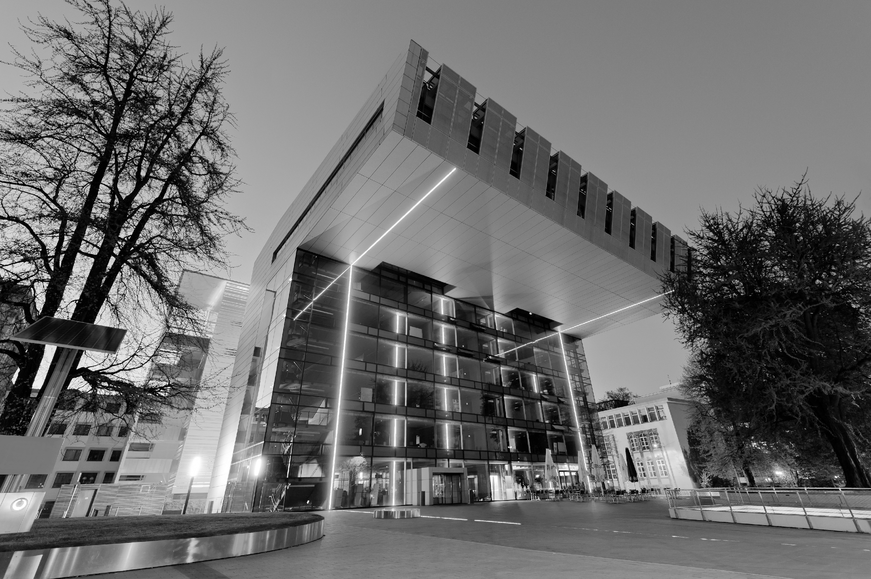

Group 9
Aachen
– Anti-Toxic Comments Bot–
Team:
Allwin Lucious
Lai Zi Cheng
Philipus Benizi Putra
Sanjay Porwal Mentors: Sumit Bhamare , Azika Amelia

Slide 2
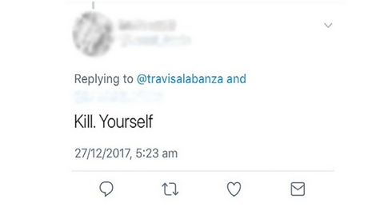
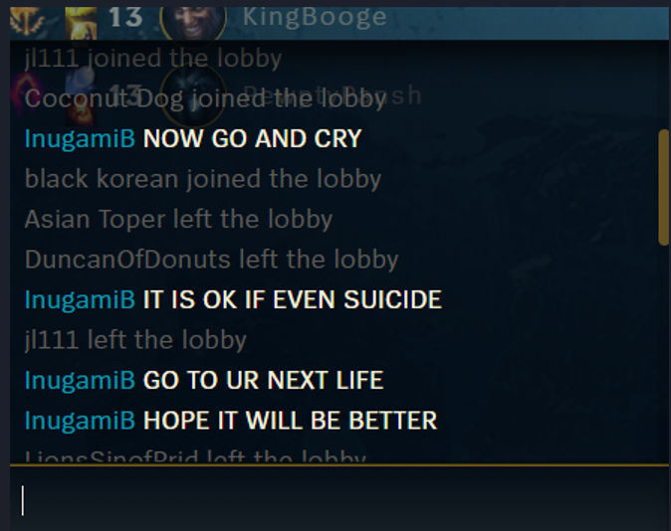
What’s our project about?
The project aims to train an algorithm which can recognize toxic and sensitive words that would be offensive to marginalized groups or/and majority in comments on the internet.
This is prevalent e.g. in online gaming, where gamers with female-sounding aliases are attacked and insulted for their gender when they make a mistake in game. Twitter is also a place, which is full of negativity.

Slide 3

Milestones
Finish line
Try multiple models and select the best one
Get a working model
Pre-Process the data
Project Phase Start

Slide 4
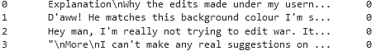
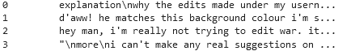
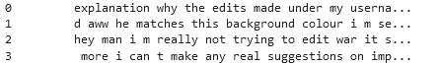
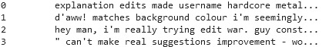
Progress
Pre Processing
Lower Casing
remove special characters and punctuations
stop word filtering

Slide 5
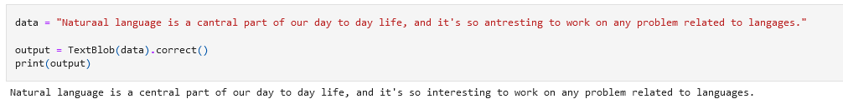
Current work
Searching for libraries which can Correct spelling
Learn to implement various NLP models

Slide 6
Challenges
Data is very difficult to pre-process
Some spellings are too wrong to be auto corrected
Removing punctuations removes apostrophes from words like “can't", turning it into “can” ,” t“.
Study and implement various NLP models

Slide 7
Challenges & Solutions
Filter out such words and replace them with their expanded form
Learning and implementing Lemmatization and Stemming which can improve model performance

